Slide 1
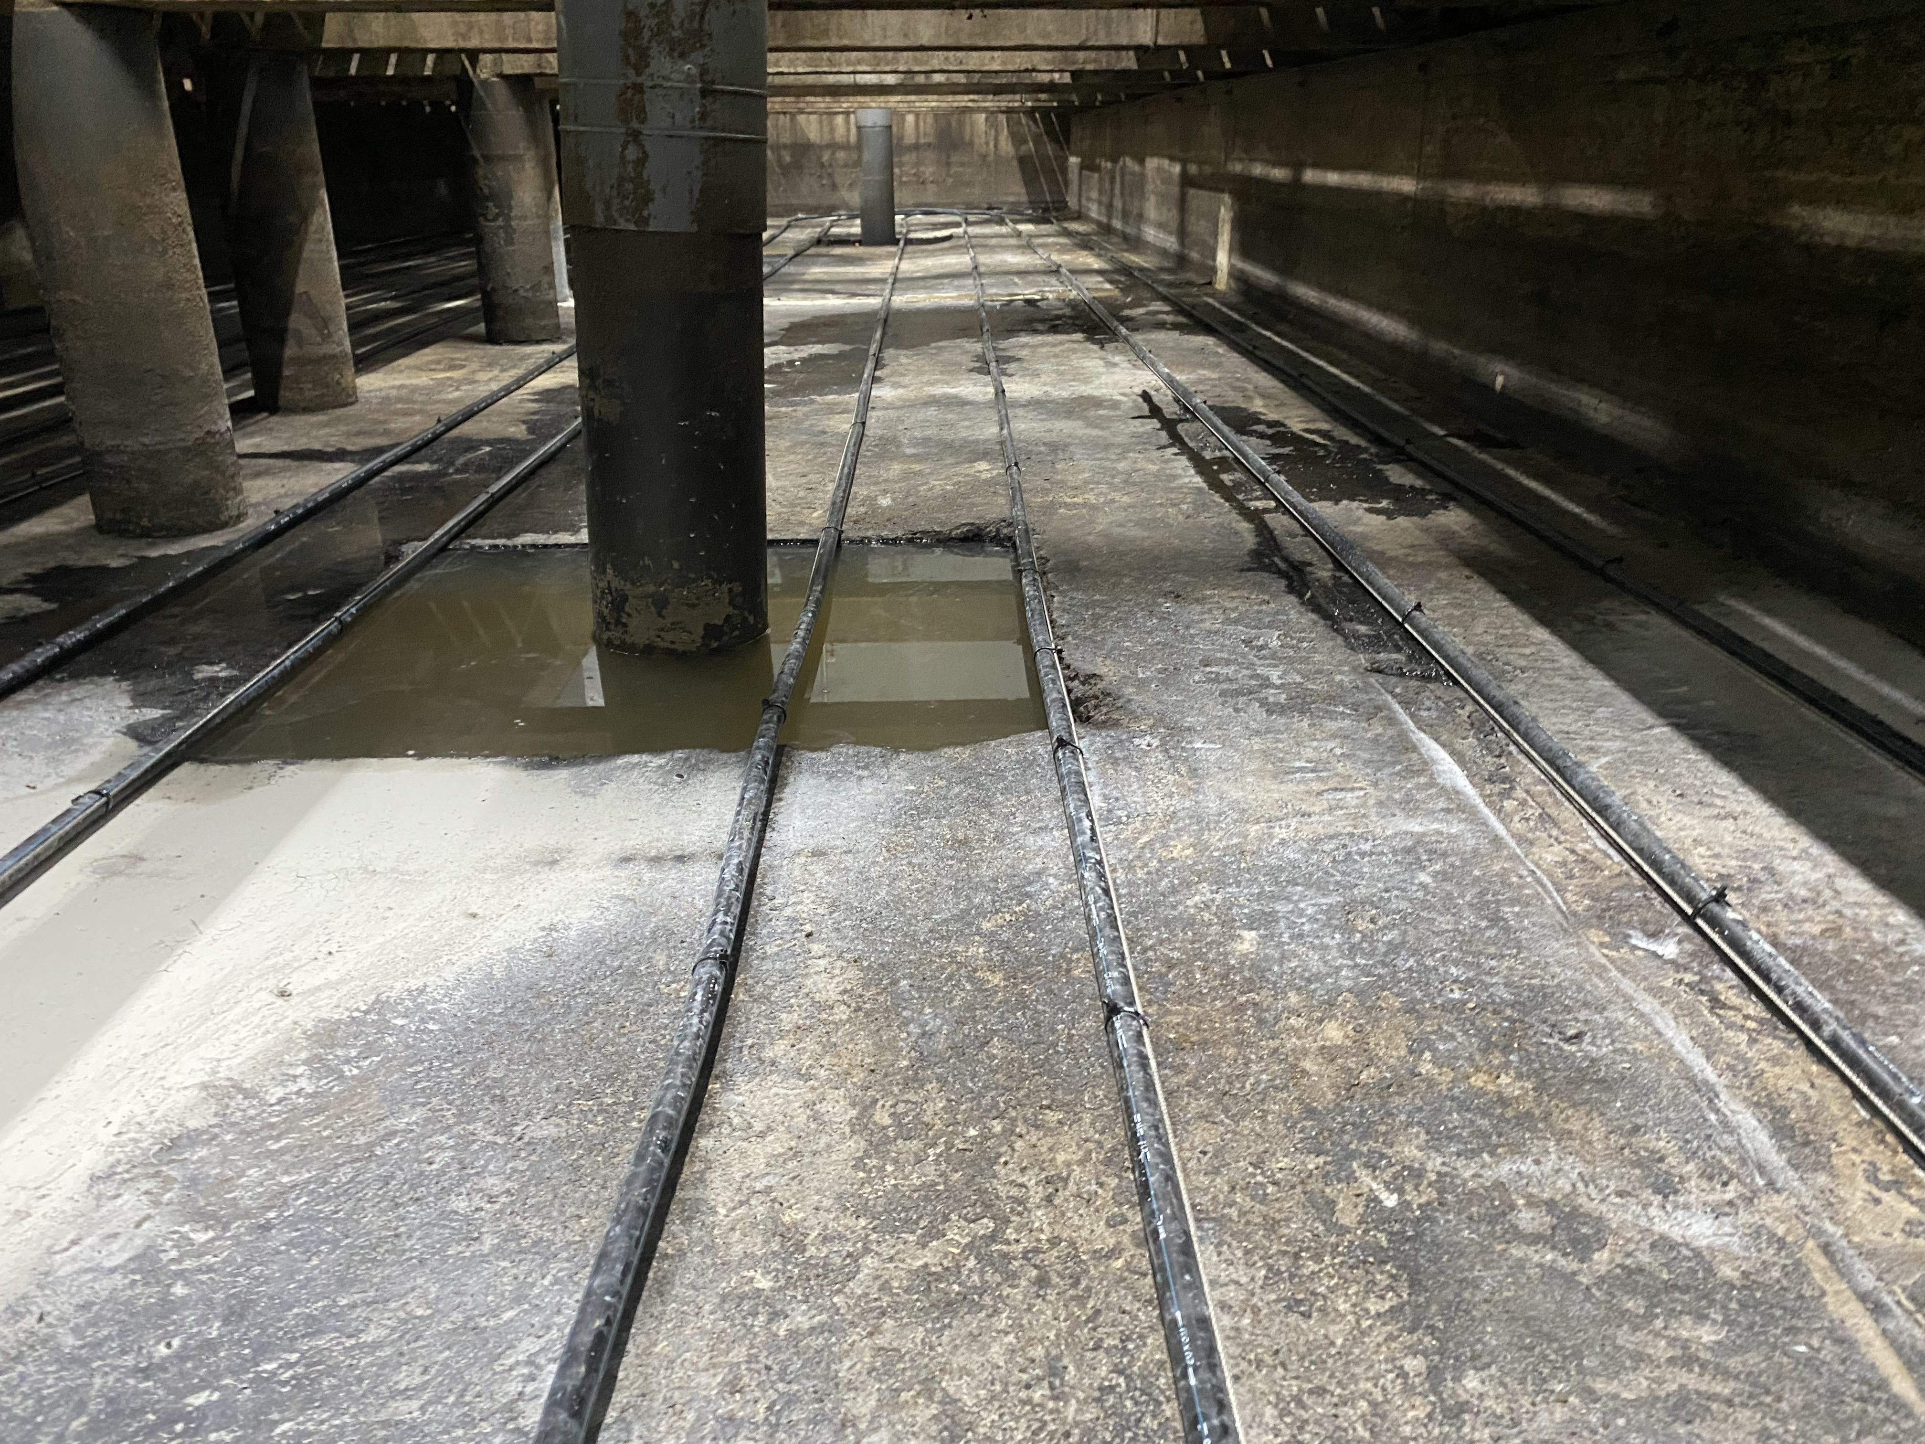
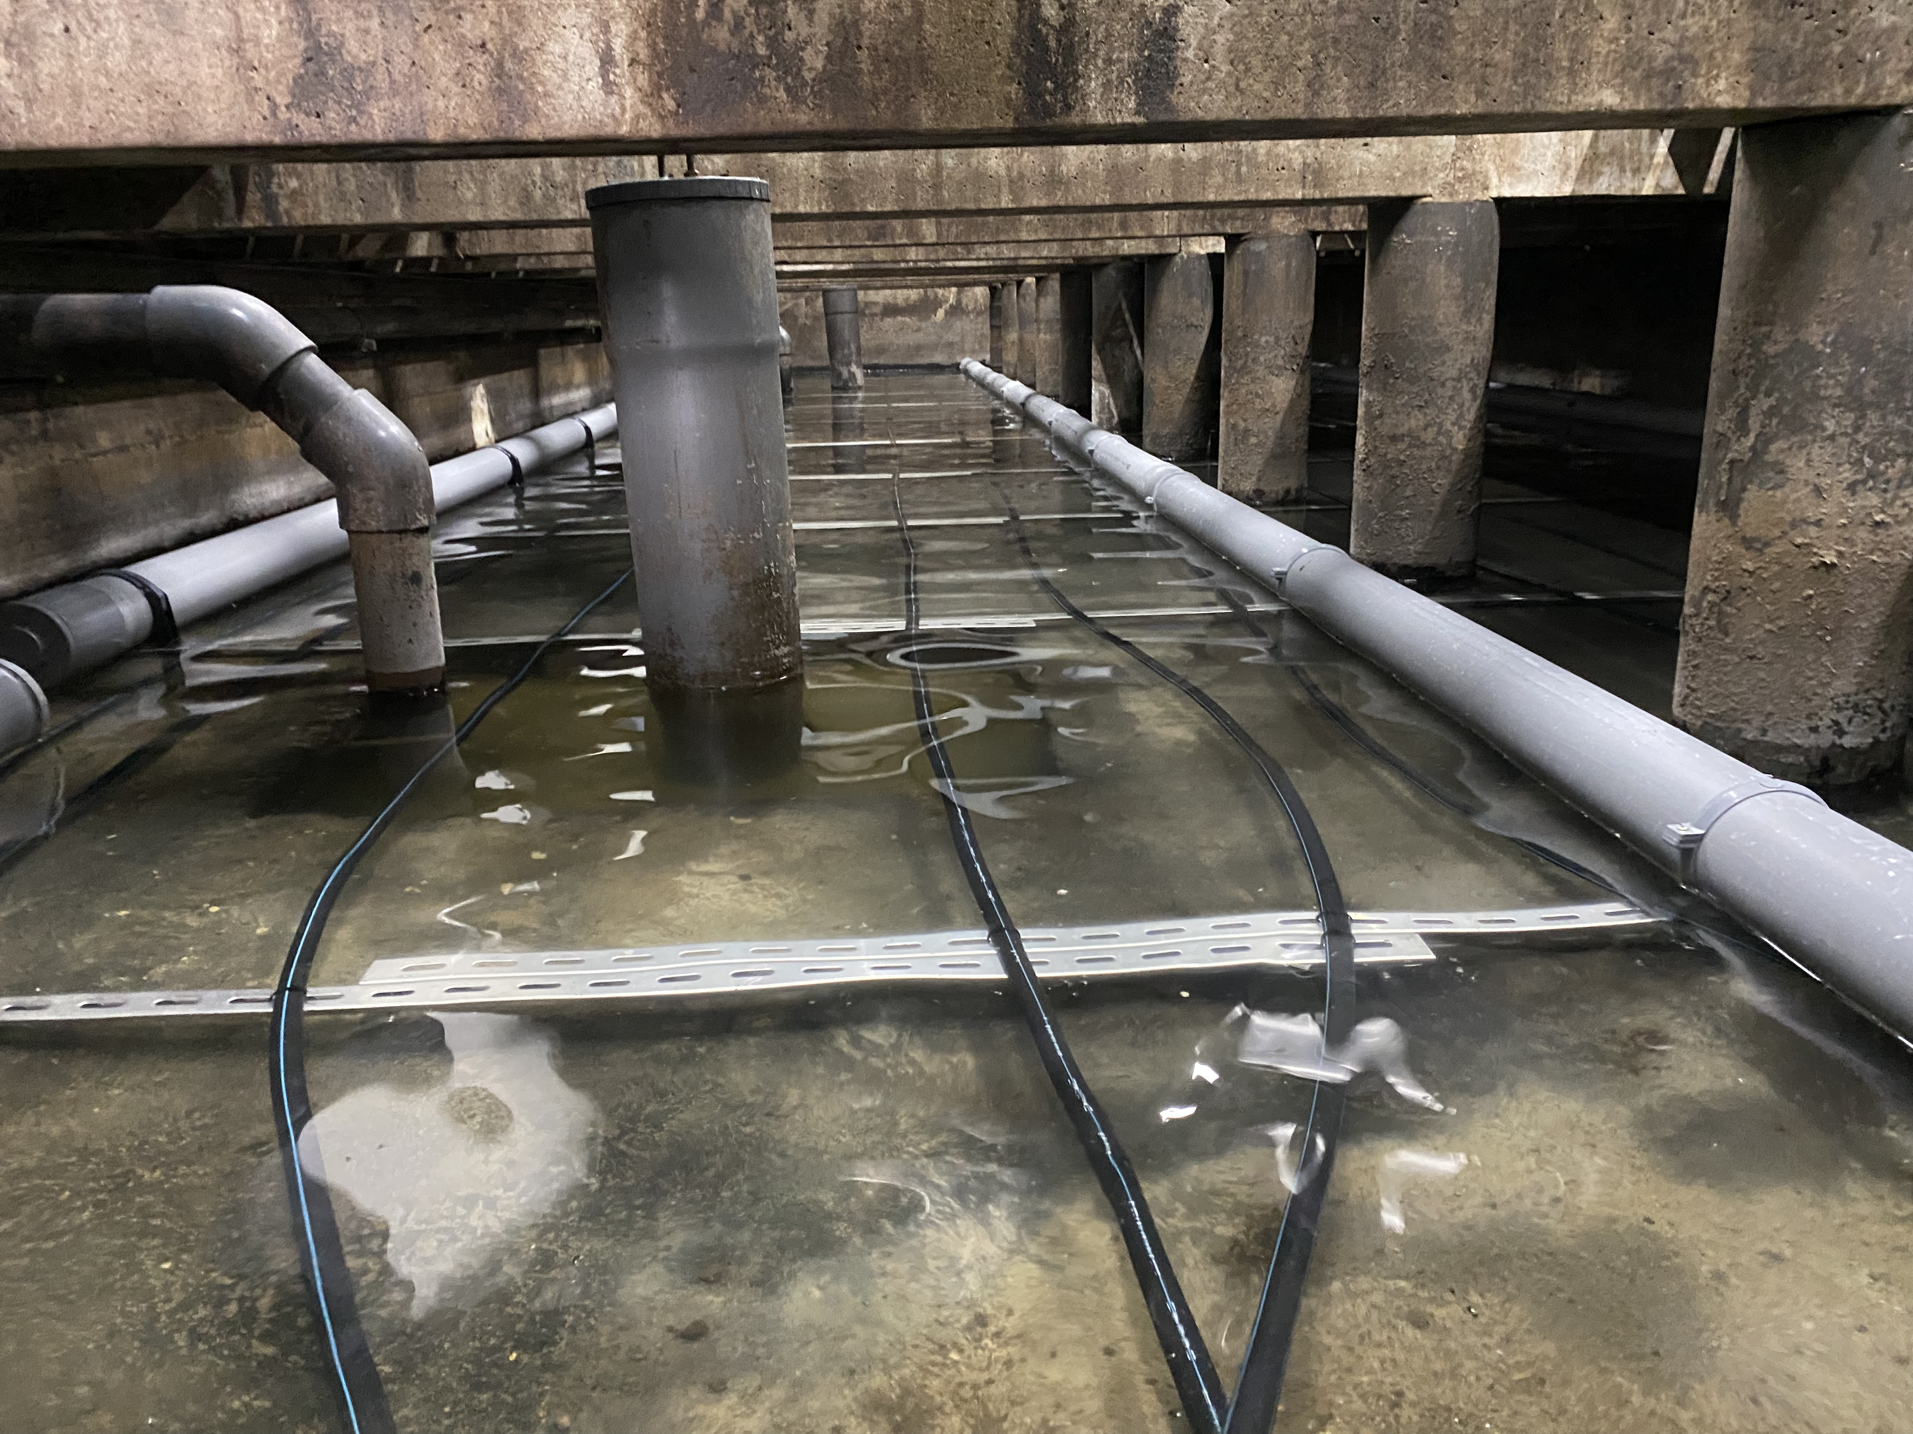

Reducing slurry temperature to lower NH₃, N₂O and CH₄ emissions from pig fattening housing
Nadine Guingand (*), Yvonnick Rousselière
Johan Thomas, Aurélien Collin
Ifip – institut du Porc
A study of the TEMPORALIS project supported by
the French ecological transition Agency (ADEME)

Slide 2


Context
NH₃
N₂O
CH₄
(Citepa, 2022)
Contribution of the pig sector
NH₃ : - 13%
GHG : -20 %
IMPLEMENTATION OF TECHNIQUES FOR THE REDUCTION OF GASEOUS EMISSIONS
? Effectiveness, applicability
France’s committements
Notes:
At the european level, France is committed to reducing its emission of ammonia by 13% and its emission of GHG by 20% by 2030 compared to 2005 emission. In France, in 2022, pigs are responsible of 8% for ammonia, 7% for nitrous oxide and 9% for methane at the national level, according to Citepa who is the french organization in charge of inventories
Meeting these commitments requires the implementation of reduction techniques in our livestock farms.

Slide 3



Manure cooling – the principle
Reduction of the slurry temperature by captation of calories
Captation of calories by the heat transfer fluid circulating
in the circuit of pipes
Evaporator
Condenser
Circuit of pipes installed in the prepit
Heating/tapwater
Notes:
The principle is relatively simple and based on the captation of calories present in the slurry. Those calories can be used for heating or preheating water or air. A circuit of pipes filled with a heat transfer fluid is installed in the prepit and allows the recovery of calories from the slurry.

Slide 4
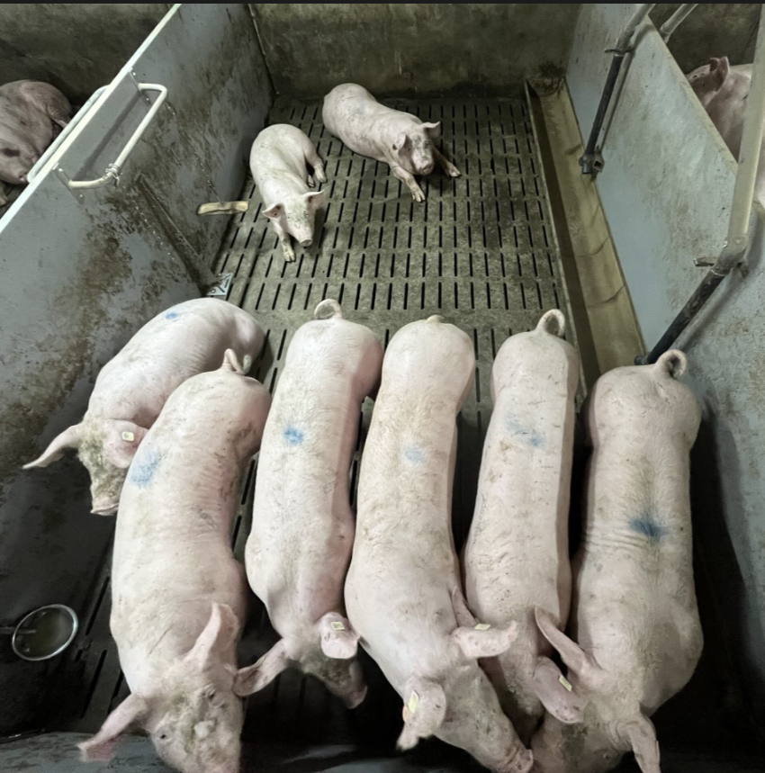
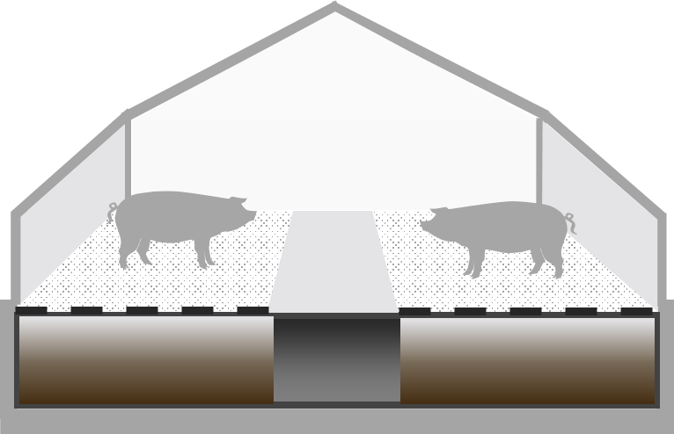
Experimental design
54
30 to 118 kg
Fully slatted floor
Slurry storage
Diffuse ceiling and under-floor extraction
Conventional setpoint temperature (22°C)
MCSb room
MCSf room
Reference room
Multiphase dietary strategy
Notes:
Three rooms with the same design were implicated in our study

Slide 5
Experimental design
30- meter circuit of pipes
Fixed directly on the pit bottom
Filled with a heat transfer fluid (33% glycol)
Pit Bottom
20 W.m⁻²
MCSf room
Reference room
MCSPB room
MCSPB : Manure Cooling System – Pit Bottom

Slide 6
Experimental design
2 consecutive batches between May to December
Raft floating on the surface of the slurry
Pit Bottom
Floating System
Same technical design than MCSPB
Reference room
MCSPB room
MCSF room
MCSFS : Manure Cooling System – Floating System

Slide 7
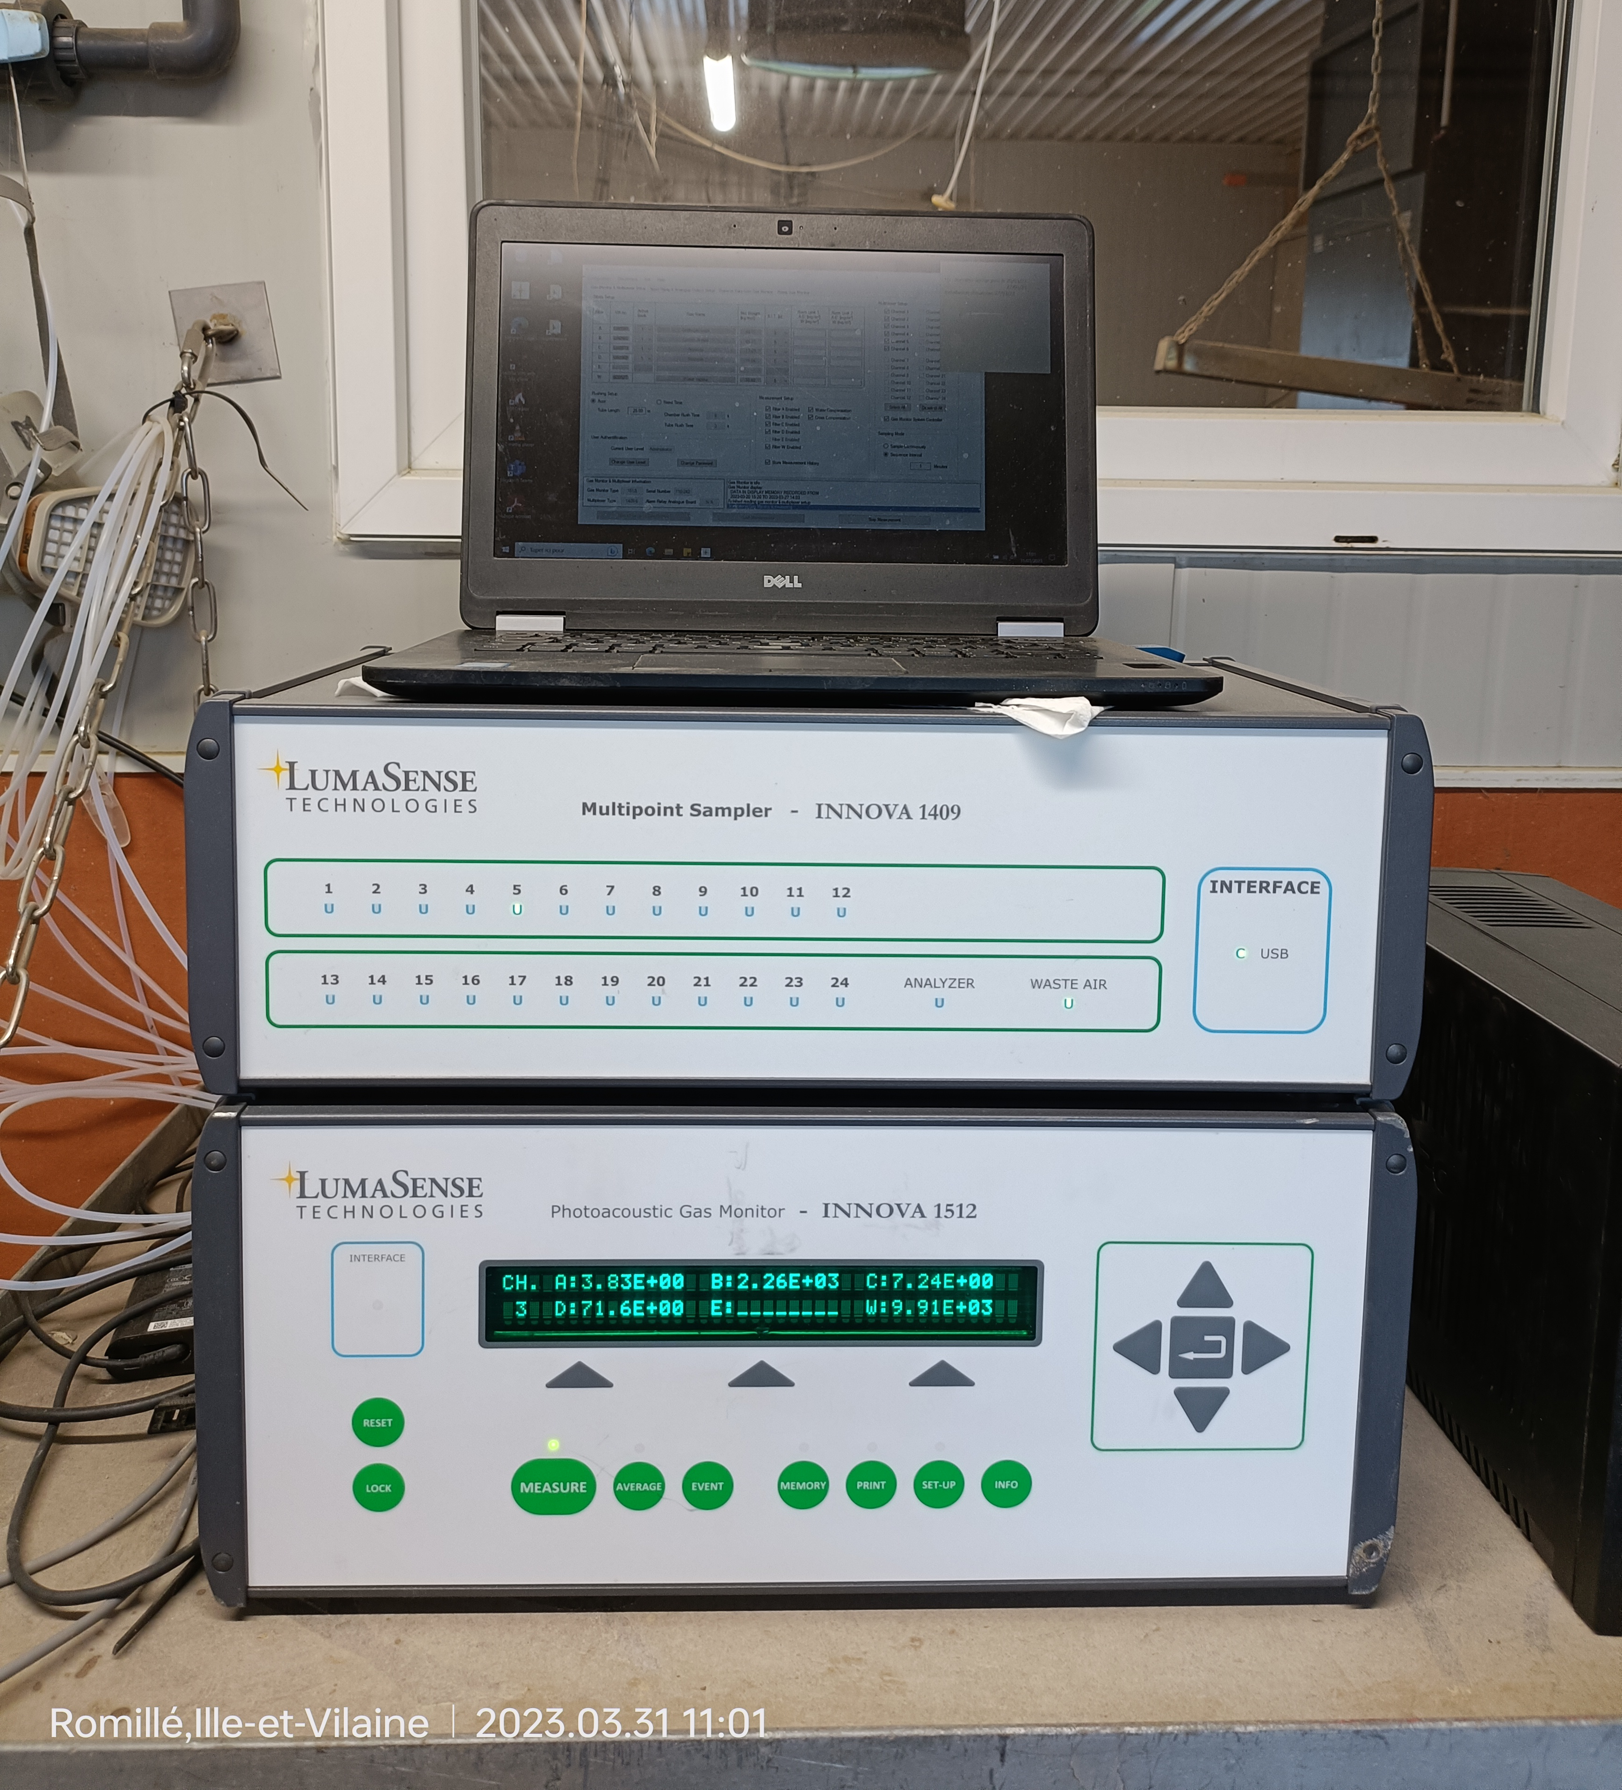

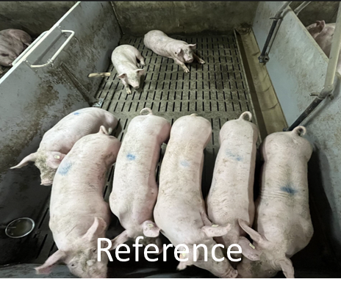
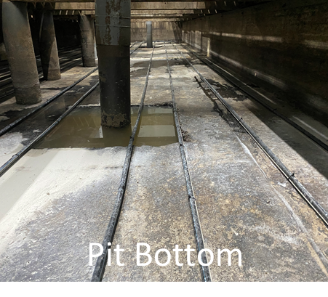
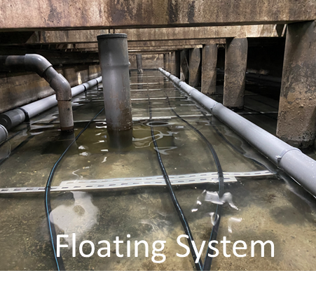

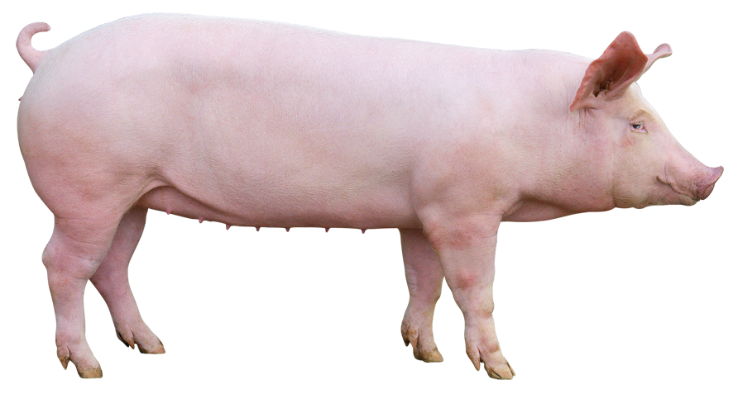
Measurements and recordings
PIG WEIGHING
Entry, feed transition and slaughter + carcass data
Zootechnical aspect
FEED WEIGHING
Every day

Slide 8


Measurements and recordings
PIG WEIGHING
Entry, feed transition and slaughter + carcass data
SLURRY
Height every 2 weeks -> volume
Sampling : feed transition + slaughter
Environmental aspect
GAS (NH₃, N₂O, CH₄)
Ambient air - Every 3 minutes
FEED WEIGHING
Every day

Slide 9

Measurements and recordings
PIG WEIGHING
Entry, feeding transition and slaughter+ carcass data
SLURRY
Height every two weeks -> volume
Sampling : feed transition + slaughter
Ambience
GAS (NH₃, N₂O, CH₄)
Ambient air – every 3 minutes
FEEDING WEIGHING
Every day
TEMPERATURE (Ambience and Slurry)
VENTILATION RATE
Every 15 minutes

Slide 10
Results – zootechnical performance
National Value
ADG g.d⁻¹
917±186 b
954±103 a
932±91 ab
803
FCR kg.kg⁻¹
2,56±0,2 a
2,50±0,1 a
2,50±0,1 a
2,75
Meat lean
60,9±2,2 a
61,3±2,0 a
60,9±1,9 a
60,7
(a,b) : Values accompanied by different letters on the same line indicate a statistically significant difference at the 5% level

Slide 11


Ambience – Temperature in the air
Average values expressed in °C
Air
26,5±1,9 (a)
25,7±2,2 (b)
26,5±2,0 (a)
25,0±0,8 (a)
23,9±1,1 (b)
25,2±1,0 (a)
Set point temperature
22°C
►Reduction of the ambient temperature
for the MCSPB room
(a,b) : Values accompanied by different letters on the same line indicate a statistically significant difference at the 5% level

Slide 12
Ambience – Temperature of the slurry
Average values expressed in °C
Measures taken at the botton of the pit
Slurry
23,7±0,8 (a)
15,8±2,3 (c)
18,1±1,6 (b)
22,5±0,6 (a)
16,1±3,8 (c)
16,7±2,3 (b)
Impact of ambient temperature on slurry (Guyot et al., 2022 – Guingand et al., 2024)
Good efficiency of both MCS
(a,b) : Values accompanied by different letters on the same line indicate a statistically significant difference at the 5% level

Slide 13
Environmental aspect – NH₃
Average values expressed in kg N_NH₃.place⁻¹.year⁻¹
2,3±1,3
2,0±1,4
2,4±1,4
2,2±1,3
1,9±1,4
2,2±1,3
2,5 – 3
Guingand et Courboulay, 2019
Philippe et al., 2011
Santonia et al., 2017

Slide 14
Environmental aspect – NH₃
Average values expressed in kg N_NH₃.place⁻¹.year⁻¹
2,3±1,3
2,0±1,4
2,4±1,4
2,2±1,3
1,9±1,4
2,2±1,3
Reduction lower than 20%
for the « Pit Bottom » System

Slide 15
Environmental aspect – NH₃
Average values expressed in kg N_NH₃.place⁻¹.year⁻¹
2,3±1,3
2,0±1,4
2,4±1,4
2,2±1,3
1,9±1,4
2,2±1,3
No effect of the « Floating System »

Slide 16
Environmental aspect – NH₃
Average values expressed in kg N_NH₃.place⁻¹.year⁻¹
2,3±1,3
2,0±1,4
2,4±1,4
2,2±1,3
1,9±1,4
2,2±1,3
Hansen et al., 2013 : relation between installed cooling capacity and ammonia reduction : 10 % per 10 W/m²
► In our study : 20 W/m² –> 20 % - close to our result
Holm et al., 2016 : Reduction (%) =1,5 x – 0,008x2 with x = Cooling capacity in W/m²
► In our study : with 20W/m² -> 26,8% - higher than our result

Slide 17
Environmental aspect – N₂O
Average values expressed in kg N_N₂O.place⁻¹.year⁻¹
0,08±0,02
0,08±0,02
0,09±0,02
0,08±0,01
0,08±0,01
0,08±0,02
0,10 – 0,25
Philippe et al., 2015
IPCC, 2019
No effect of both MCS

Slide 18
Environmental aspect – CH₄
Average values expressed in kg C_CH₄.place⁻¹.year⁻¹
8,5±0,1
2,2±0,1
3,4±0,2
4,5±0,2
1,4±0,3
2,0±0,5
2– 5
Philippe et al., 2011
IPCC, 2019

Slide 19
Environmental aspect – CH₄
Average values expressed in kg C_CH₄.place⁻¹.year⁻¹
8,3±0,1
2,2±0,1
3,4±0,2
4,5±0,2
1,4±0,3
2,0±0,5
High efficiency of the Pit Bottom System (70%)

Slide 20
Environmental aspect – CH₄
Average values expressed in kg C_CH₄.place⁻¹.year⁻¹
8,5±0,1
2,2±0,1
3,4±0,2
4,5±0,2
1,4±0,3
2,0±0,5
High efficiency of the Floating System (55%)

Slide 21
Environmental aspect – CH₄
Average values expressed in kg C_CH₄.place⁻¹.year⁻¹
8,5±0,1
2,2±0,1
3,4±0,2
4,5±0,2
1,4±0,3
2,0±0,5
Reduction of the activity of methanogenic bacteria in the cold slurry

Slide 22

Conclusions
Efficiency lower than expected on NH₃…
Lower temperature
on the area between slurry and slatted floor
Degradation
of animal welfare
Consequences on performance?
20 W/m²
40 W/m²
Cette photo par Auteur inconnu est soumise à la licence CC BY-NC

Slide 23

Conclusions
Efficiency lower than expected on NH₃…
… but higher than expected on CH₄
High interest in term of National Low-Carbon Strategy
Increased profit through energy recovery from slurry (not yet analyzed)
Implantation in existing building can be difficult
(volume of the pit for the MCSPB – adaptation for the MCSF)
Expensive technique although the save of energy
Cette photo par Auteur inconnu est soumise à la licence CC BY-NC

Slide 24

Conclusions
The MCSPB is easier to implement than the MCSF
Especially in new buildings
Maintenance of the technique
Evolution of circuit porosity ? Risk of leaks ?.....
Cette photo par Auteur inconnu est soumise à la licence CC BY-NC

Slide 25







Thanks for your attention !
        nadine.guingand@ifip.asso.fr
            07 62 53 68 21
              IFIP – Pacé - France
This study is part of the project called TEMPORALIS *
funded by ADEME
*Température en porcheries et réduction des émission d’ammoniac du lisier – 1962C0014

